Slide 1
MFCS (CS6L015)
Dr. Padmalochan Bera
Associate Professor (CSE)
School of Electrical and Computer Sciences
IIT Bhubaneswar
plb@iitbbs.ac.in

Slide 2
Lecture1: Foundation of Logic
Coverage: Propositional logic, predicate logic, satisfiability, logic programming – prolog, proof techniques, etc.
Why study logic in computer science?
Proving correctness of a program
Circuit verification
Checking various properties of protocols and system specification
Definition: A proposition is a declarative statement (i.e., a sentence that declares a fact) that is either true (T) or false (F) but not both

Slide 3

Lecture 1: Foundation of Logic
Are these statements proposition?
Washington D. C is the capital of USA
What time is it?
2+2 =5
1+1 = 2
X+1 = 7
Propositional or statement variables to represent proposition – letters p, q, r, s,..
Truth values – true (T) or false (F)
Compound proposition formed of existing proposition using logical operators/connectives ( )

Slide 4
Lecture 1: Foundation of Logic
Negation (¬): Let p be a proposition. The negation of p (denoted by ¬p), is the statement “it is not the case that p.”
The proposition ¬p is read as “not p”. The truth value of the ¬p is the opposite of the truth value of p.
Find the negation of the following propositions
Susanth’s PC runs Linux
Swapnil’s Smartphone has at least 32 GB memory
p | ¬p
F | T
T | F

Slide 5
Lecture 1: Foundation of Logic
Conjunction (∧): Let p and q be propositions. The conjunction of p and q (denoted by p ∧ q) is the proposition “p and q”. The conjunction p ∧ q is true when both p and q are true and is false otherwise.
p | q | p ∧ q
F | F | F
F | T | F
T | F | F
T | T | T

Slide 6
Lecture 1: Foundation of Logic
Disjunction (∨): Let p and q be propositions. The disjunction of p and q (denoted by p ∨ q) is the proposition “p or q”. The disjunction p ∨ q is false when both p and q are false and is true otherwise.
p | q | p ∨ q
F | F | F
F | T | T
T | F | T
T | T | T
p | q | p ∨ q
F | F | F
F | T | T
T | F | T
T | T | T

Slide 7
Lecture 1: Foundation of Logic
Implication (→ ): Let p and q be propositions. The conditional statement p → q is the proposition that is false when p is true and q is false, and true otherwise.
q is true on the condition that p is true. This is also called an implication.
There are various ways to express/read p → q:
“q if p”
“q when p”
“p is suﬃcient for q” or “a suﬃcient condition for q is p”
“q is necessary for p” or “a necessary condition for p is q”
“q unless ¬p”
“p implies q”
“p only if q”
“q whenever p”
“q follows from p”

Slide 8
Lecture 1: Foundation of Logic
If you get 100% in final exam you will get EX
p- you get 100%in final exam
q- you will get EX p🡪q == ¬p ∨ q
you get 100% in final exam is sufficient that you get EX
You got EX, you get 100% in final exam is necessary but not sufficient (you may still score less)
If elected, I will cut tax rates
If 2+2 = 4 then Delhi is capital of India ( T )
If 2+2 = 5 then Delhi is capital of India ( T )
If 2+2 = 4 then Bhubaneswar is capital of India ( F )

Slide 9
Lecture 1: Foundation of Logic
p | q | p🡪q
T | T | T
T | F | F
F | T | T
F | F | T

Slide 10
Lecture 1: Foundation of Logic
Exclusive or (⊕): Let p and q be propositions. The exclusive or of p and q (denoted by p ⊕ q) is the proposition that is true when either of the proposition is true but not both and is false otherwise.
p ⊕ q 🡺 (¬p v ¬ q) ∧ (p v q)
p🡨🡪q 🡺 (p🡪q) ∧ (q🡪p) = (¬p v q) ∧ (¬q v p)
p | q | p ⊕ q
F | F | F
F | T | T
T | F | T
T | T | F

Slide 11
Lecture 1: Foundation of Logic
Deﬁnition (Converse): The converse of a proposition p → q is the proposition q → p.
Deﬁnition (Contrapositive): The contrapositive of a proposition p → q is the proposition ¬q → ¬p.
Deﬁnition (Inverse): The inverse of a proposition p → q is the proposition ¬p → ¬q.
Show that the contrapositive of p → q always has the same truth value as p → q.
Show that, neither converse nor inverse of p → q has the same truth value as p → q for all truth values of p and q.

Slide 12
Lecture 1: Foundation of Logic
Biconditional Statement: Let p and q be propositions. The bi-conditional statement p ↔ q is the proposition, p if and only if q. The bi-conditional statement p ↔ q is true if p and q both having the same truth value and false otherwise.
You can take the flight iff you buy a ticket
Compound proposition

Slide 13
Lecture1: Foundation of Logic
Application of Propositional Logic:
Translating English Sentences in logical form
“You can access the Internet from campus only if you are a computer science major or you are not a freshman.”
You can access the internet from the campus – proposition a
You are a computer science major – proposition c
You are a freshman – proposition f
a → (c ∨ ¬f )
System requirement specification
System specification should be consistent

Slide 14
Lecture1: Foundation of Logic
Determine whether the following system specification is consistent:
“The diagnostic message is stored in the buffer (p) or it is retransmitted (q).” [pvq]
“The diagnostic message is not stored in the buffer.” (¬p)
“If the diagnostic message is stored in the buffer, then it is retransmitted.” (p🡪q)
A specification is consistent if the conjunction of individual specification statement is true.
Boolean Searches
Logic Puzzles
Designing digital circuit

Slide 15
Lecture1: Propositional Equivalence and Tautology
Deﬁnition [Tautology]: A compound proposition that is always true, no matter what the truth values of the proposition that occurs in it, is called a tautology.
Definition [Contradiction]: A compound proposition that is always false is called a contradiction. A compound proposition that is neither a tautology nor a contradiction is called a contingency.
Examples:
(p ∨ ¬p) is a tautology.
(p ∧ ¬p) is a contradiction.
Deﬁnition [Logical equivalence]: A compound proposition p and q are called logically equivalent if p ↔ q is a tautology. The notation p ≡ q denotes that p and q are logically equivalent.

Slide 16
Lecture1: Propositional Equivalence and Tautology
Show that p and q are logically equivalent if and only if the columns giving their truth values match
Show that ¬(p ∧ q) ≡ ¬p ∨ ¬q.
Show that ¬(p ∨ (¬p ∧ q)) and ¬p ∧ ¬q are logically equivalent by developing a series of logical equivalences.
(p ∧ q)🡪(p ∨ q) = ¬(p ∧ q) v (p ∨ q) =
¬(p ∨ (¬p ∧ q)) = ¬p ∧ ¬ (¬p ∧ q) = ¬p ∧ (p v ¬q) = (¬p ∧ p) v (¬p ∧ ¬q) = F V (¬p ∧ ¬q) = ¬p ∧ ¬q

Slide 17
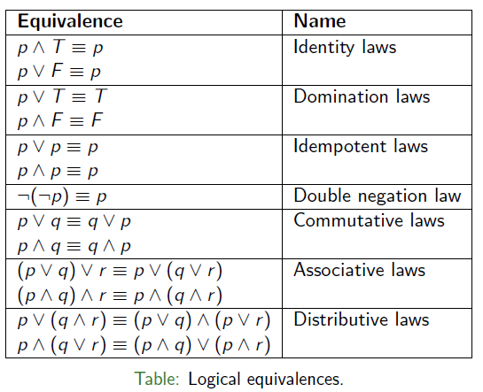
Lecture1: Propositional Equivalence and Tautology

Slide 18
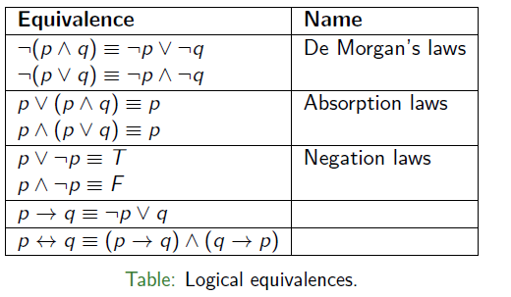

Lecture1: Propositional Equivalence and Tautology

Slide 19
Lecture1: Satisfiability
A compound proposition is satisfiable if there is an assignment of truth values to its variables that makes it true.
When no such assignments exists, that is, when the compound proposition is false for all assignments of truth values to its variables, the compound proposition is unsatisfiable.
NB: a compound proposition is unsatisfiable if and only if its negation is true for all assignments of truth values to the variables, that is, if and only if its negation is a tautology.

Slide 20
Lecture1: Satisfiability
Ex: Determine whether each of the compound propositions (p ∨¬q) ∧ (q ∨ ¬r) ∧ (r ∨ ¬p), (p ∨ q ∨ r) ∧ (¬p ∨ ¬q ∨ ¬r), and (p ∨ ¬q) ∧ (q ∨ ¬r) ∧ (r ∨ ¬p) ∧ (p ∨ q ∨ r) ∧ (¬p ∨ ¬q ∨ ¬r) is satisfiable.
Application of Satisfiability: many problems in digital circuit property verification, robotics, software testing, network security can be modelled as propositional satisfiability
Ex: Solve sudoku puzzle for 9x9 grid made up of 9 3x3 subgrids called blocks. – Write the propositions for modelling sudoku puzzle problem as propositional satisfiability.

Slide 21
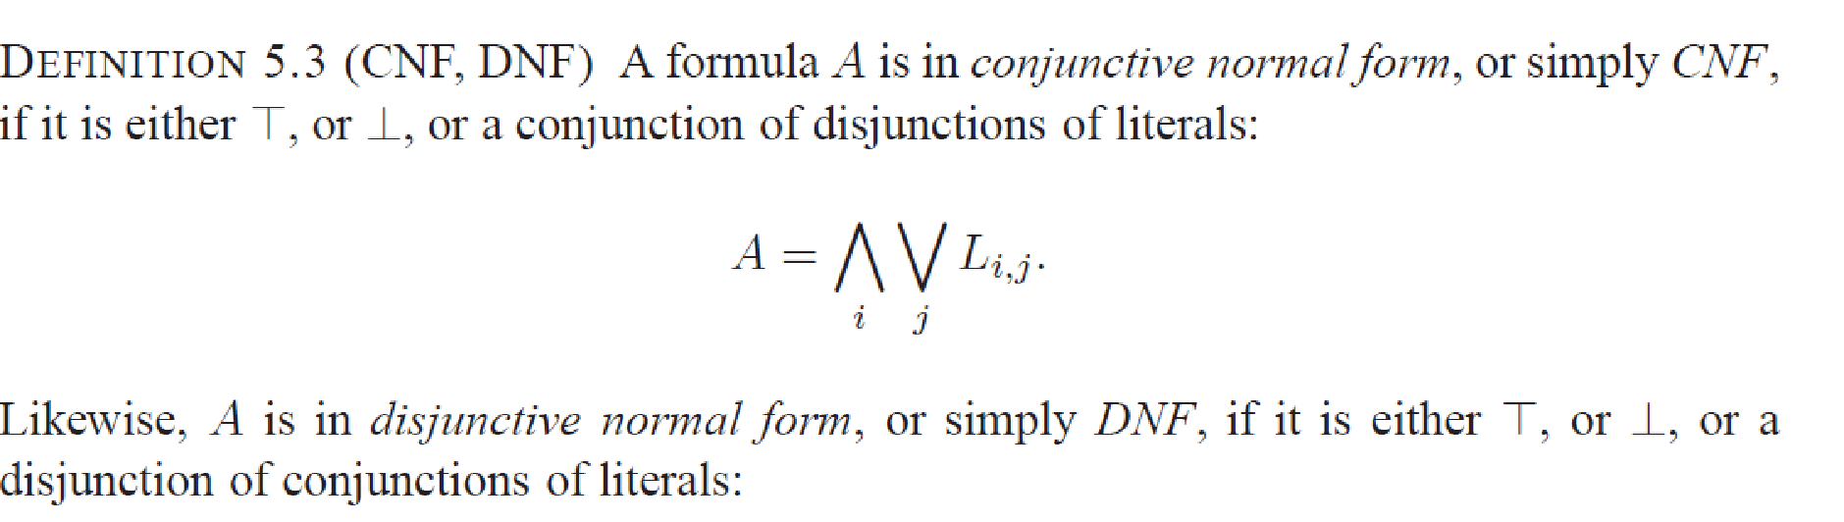
SAT Problem
A literal is either an atom A or a negation ￢A of an atom.
A clause is a disjunction L1 ∨. . .∨Ln, n ≥ 0 of literals. When n = 0, the clause is called empty and denoted by When n = 1 we say that the clause is unit. The clause is Horn if at most one of the Li’s is a positive literal.
(p v ¬q) ∧ (r v s v t)
CNF Transformation using rules

Slide 22
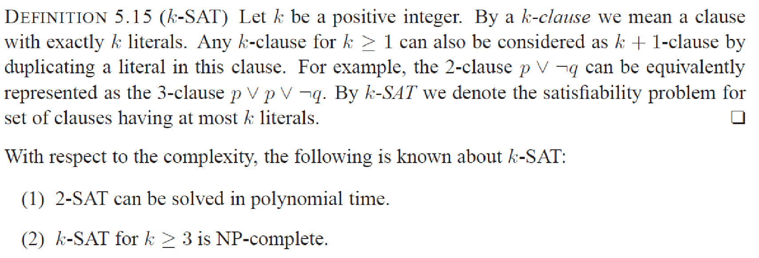
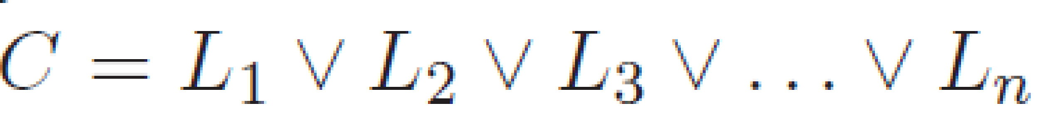
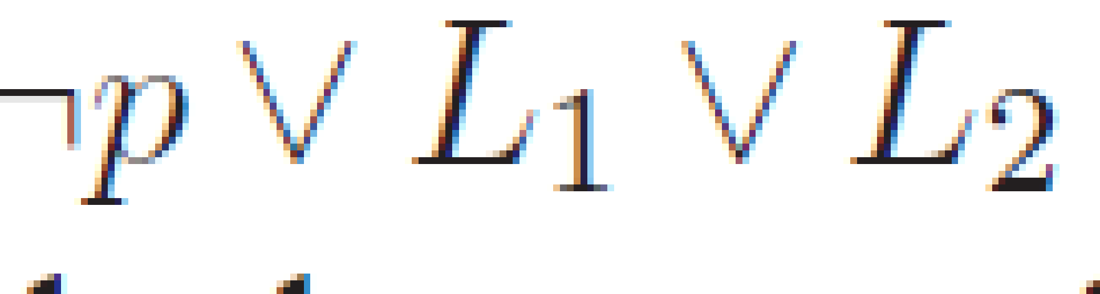

SAT problem

Slide 23
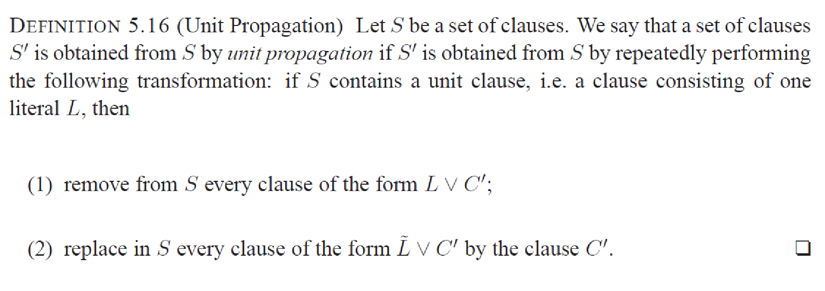
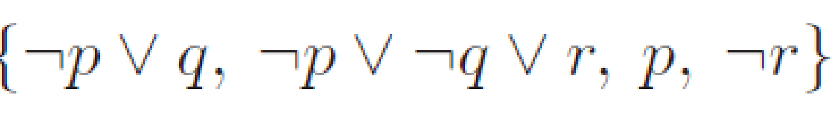
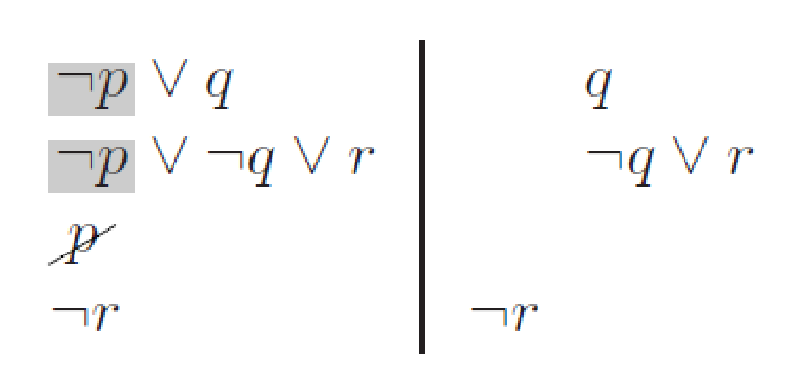
Unit Propagation

Slide 24
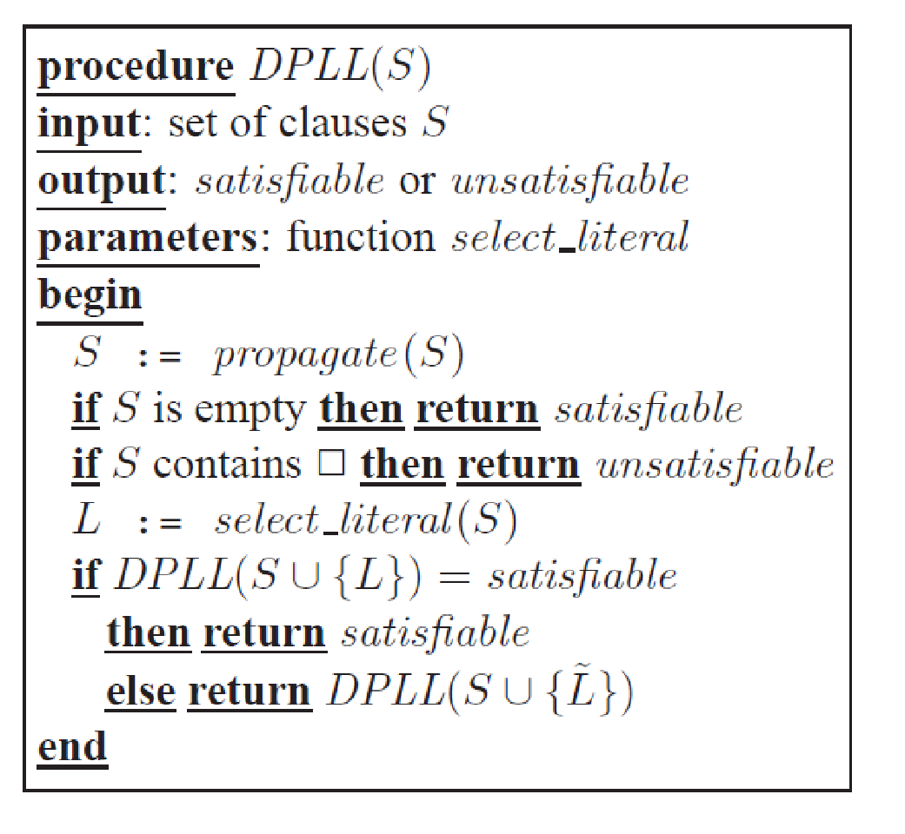
DPLL Algorithm for Satisfiability

Slide 25
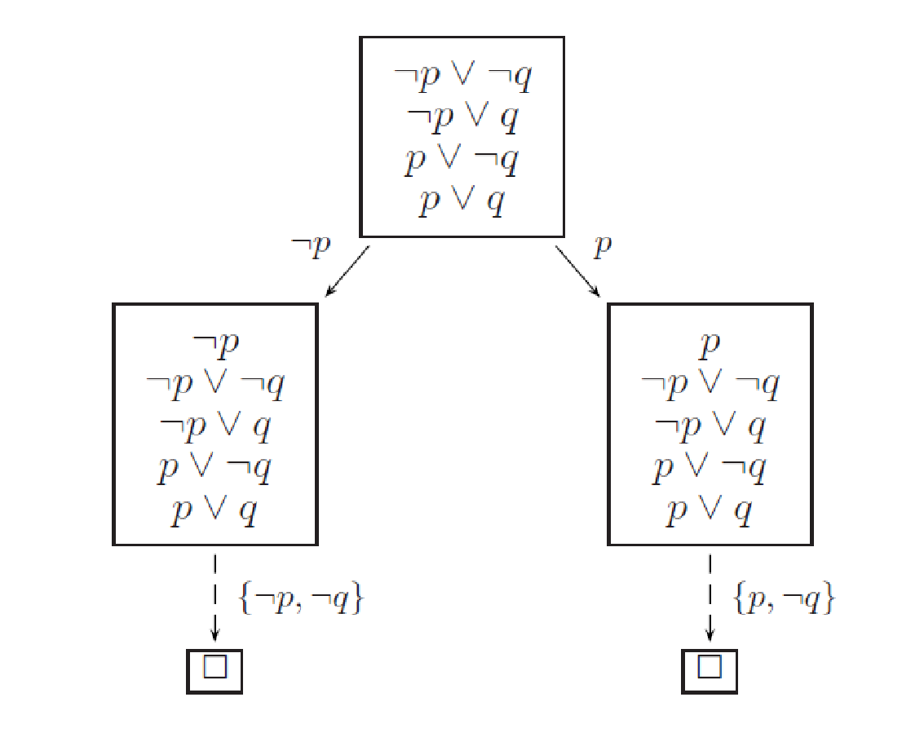
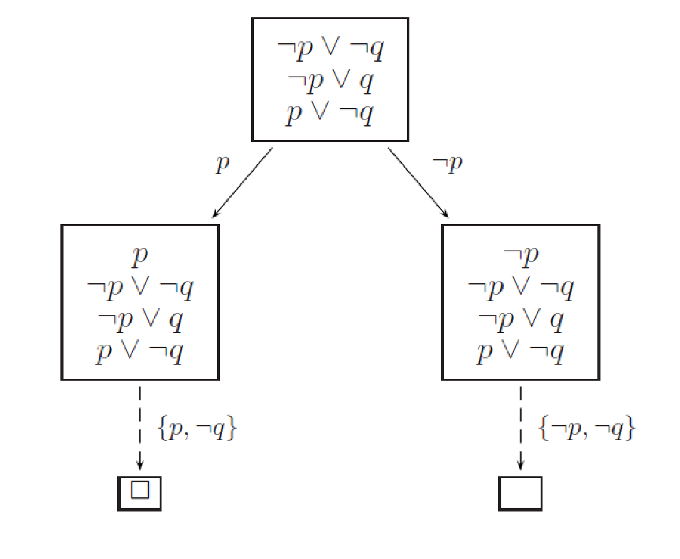
DPLL Example

Slide 26
SAT Problem
SAT is a typical search problem. We are given an instance I (that is, some input data specifying the problem at hand, in this case a Boolean formula in conjunctive normal form), and we are asked to find a solution S (an object that meets a particular specification, in this case an assignment that satisfies each clause). If no such solution exists, we must say so.
A search problem is specified by an algorithm C that takes two inputs, an instance I and a proposed solution S, and runs in time polynomial in |I|. We say S is a solution to I if and only if C(I, S) = true.
The fastest algorithms we have are still exponential on their worst-case inputs.
2-SAT problem is P - if all clauses have only two literals, then SAT can be solved in linear time by finding the strongly connected components of a particular graph constructed from the instance

Slide 27
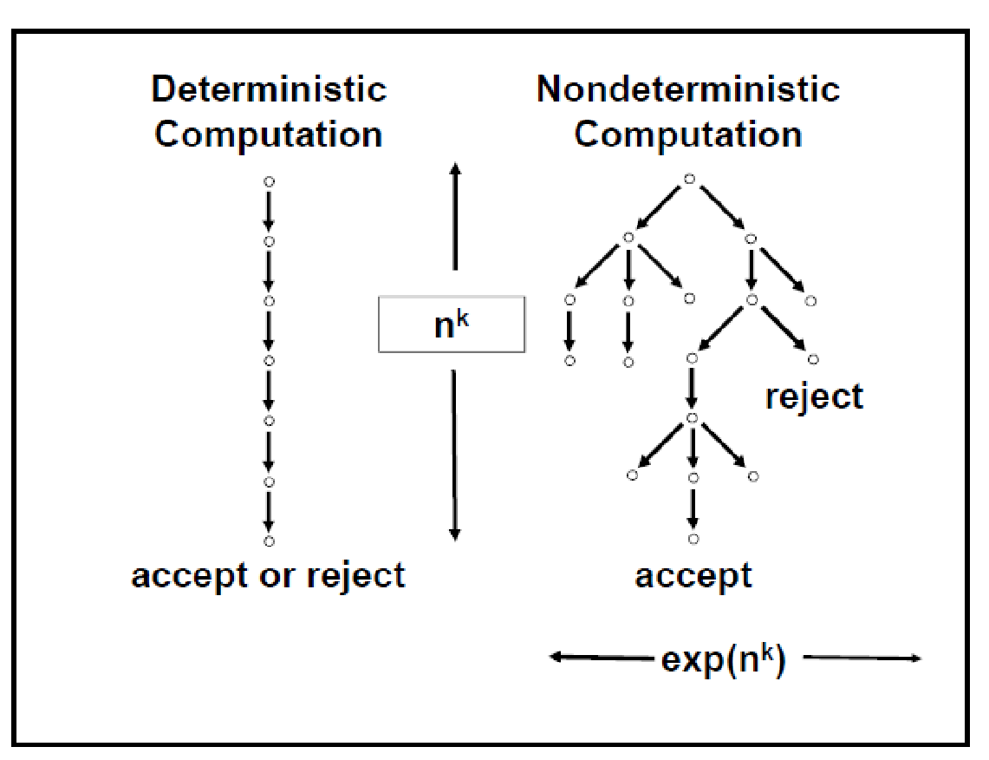
Deterministic vs Nondeterministic Computation
A deterministic algorithm that performs f(n) steps always finishes in f(n) steps and always returns the same result. A non deterministic algorithm that has f(n) levels might not return the same result on different runs. A non deterministic algorithm may never finish due to the potentially infinite size of the fixed height tree.

Slide 28
2SAT Problem (Linear Time Algo.)
Think of clauses as implications a v b’ = a’ 🡪 b’
Think of a graph with literals as nodes
Find strongly connected components
Variable and its negation should not be in the same component
• Example 1: (a’ + b) (b’ + c) (c’ + a)
• Example 2: (a’ + b) (b’ + c) (c’ + a) (a + b) (a’ + b’)
/* 6 vertices and 10 edges in the graph*/
a->b; b’->a’ /*cycle between a and a’*/
a’->b; b’->a
a->b’; b->a’
b->c; c->a

Slide 29
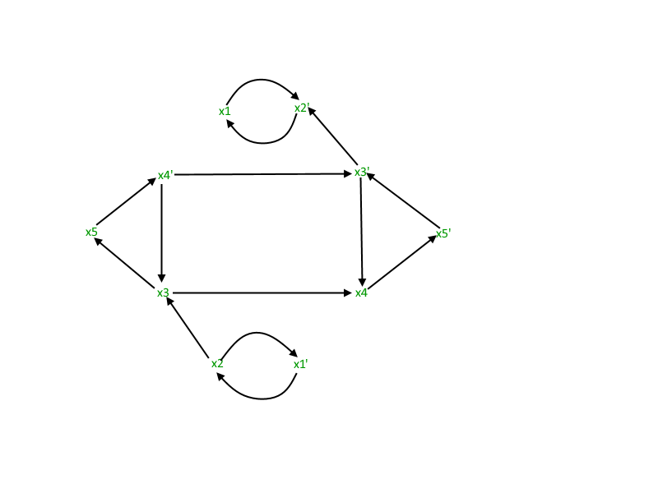
2SAT Problem
A strongly connected component in a graph is a sub-graph in which every node is reachable from other node in the sub-graph. For example: x3’, x4 and x5’ and the related edges forms a strongly connected component. Similarly, x1 and x2’ do.
NB: Here, the whole graph is a connected component of itself. But, not a strongly connected component.
In 2SAT problem, we look for the case, if a variable and its complement present in a strongly connected component
In other words, we look for finding a cycle between a variable and its complement in the graph.
(x1 v x2) ∧ (x2’ v x3) ∧ (x1’ v x2’) ∧ (x3’ v x4) ∧ (x3’ v x5) ∧ (x4’ v x5’) ∧ (x3 v x4)

Slide 30
Greedy Algorithm for finding SAT of Horn formula
Input: a Horn formula /*satisfiability of horn clauses < > 2 SAT*/
Output: a satisfying assignment, if one exists
Algorithms
set all variables to false
while there is an implication that is not satisfied:
set the right-hand variable of the implication to true
if all pure negative clauses are satisfied: return the assignment
else: return ‘‘formula is not satisfiable’’
For instance, suppose the formula is (w ∧ y ∧ z) ⇒ x, (x ∧ z) ⇒ w, x ⇒ y, ⇒ x, (x ∧ y) ⇒ w, (z). We start with everything false and then notice that x must be true on account of the singleton implication ⇒ x. Then we see that y must also be true, because of x ⇒ y. And so on.
(w’ v y’ v z’ v x) (x’ v z’ v w) (x’ v y) (F v x) (x’ v y’ v w) (z)
X = T, Z =T, Y =T, W = T

Slide 31
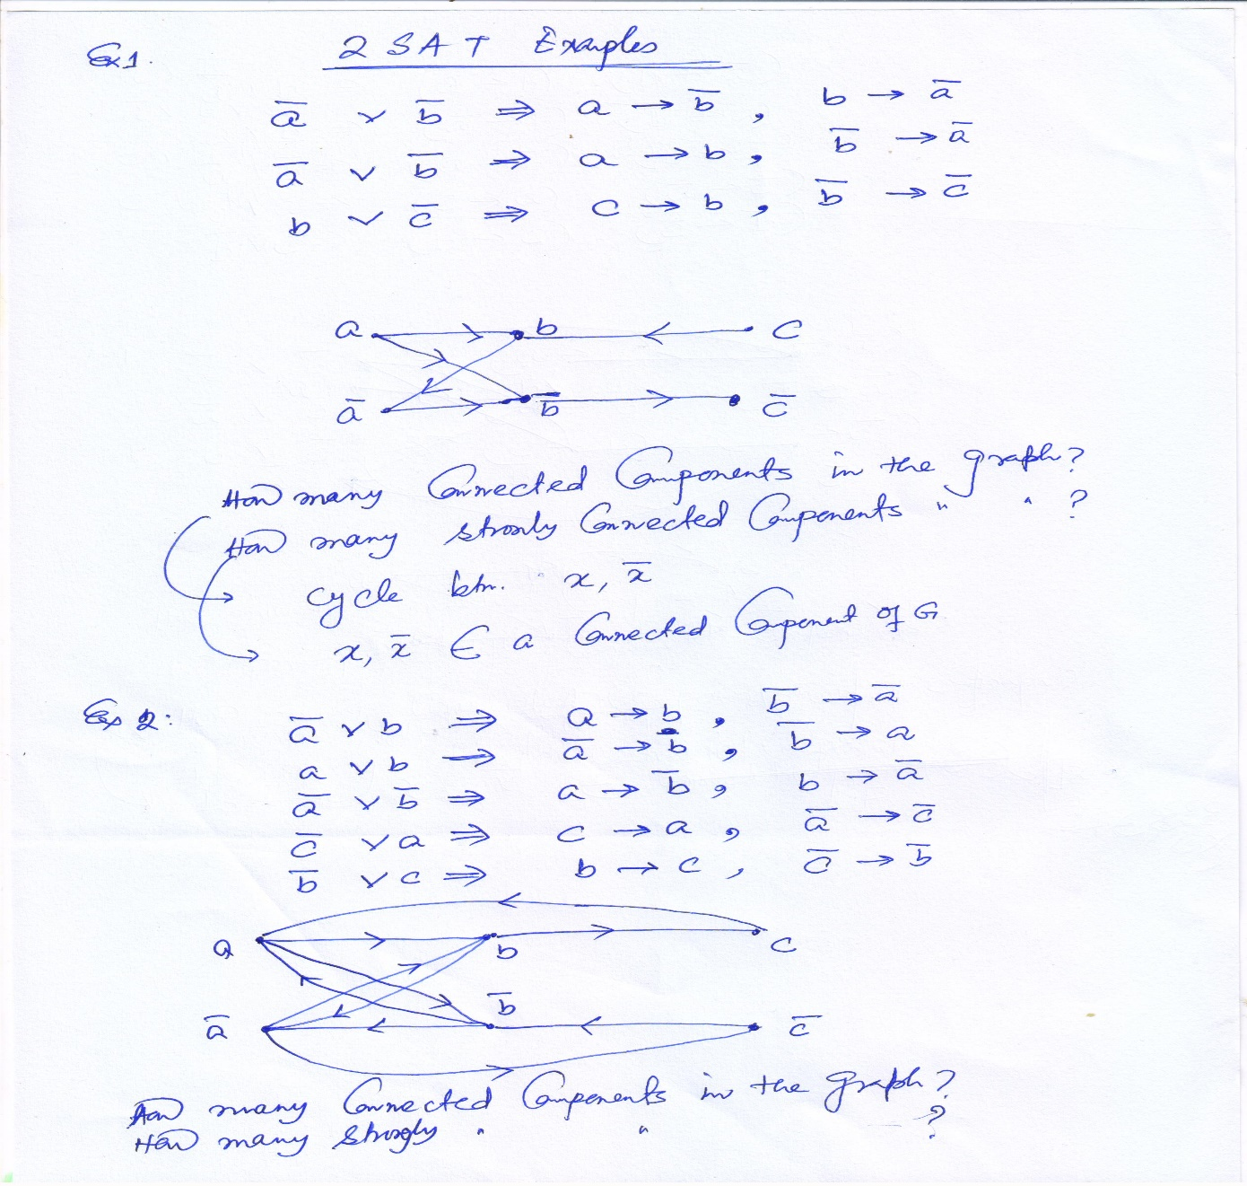
2SAT Example

Slide 32
3 SAT is NP complete
S is in exponential size of the Instance |I|
Can we design graph for 3-CNF clauses and decide??
Complexity:
Selecting Literal (Branching)
Backtracking. It is the backtracking that causes exponential behavior of the search procedure. (State based and conflict analysis driven)
efforts in the satisﬁability checking community at reducing the amount of backtracking in search procedures.
DPLL applies heuristics on Literal selection and backtracking
{¬p ∨ q, ¬p ∨ ¬q ∨ r, ¬p, ¬r}. /* Pure Literal Rule*/
Good Implementation of Unit propagation

Slide 33
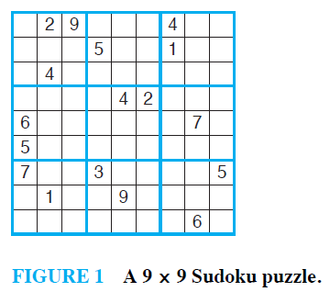
Lecture1: Application of Satisfiability # Solving Sudoku Puzzle

Slide 34
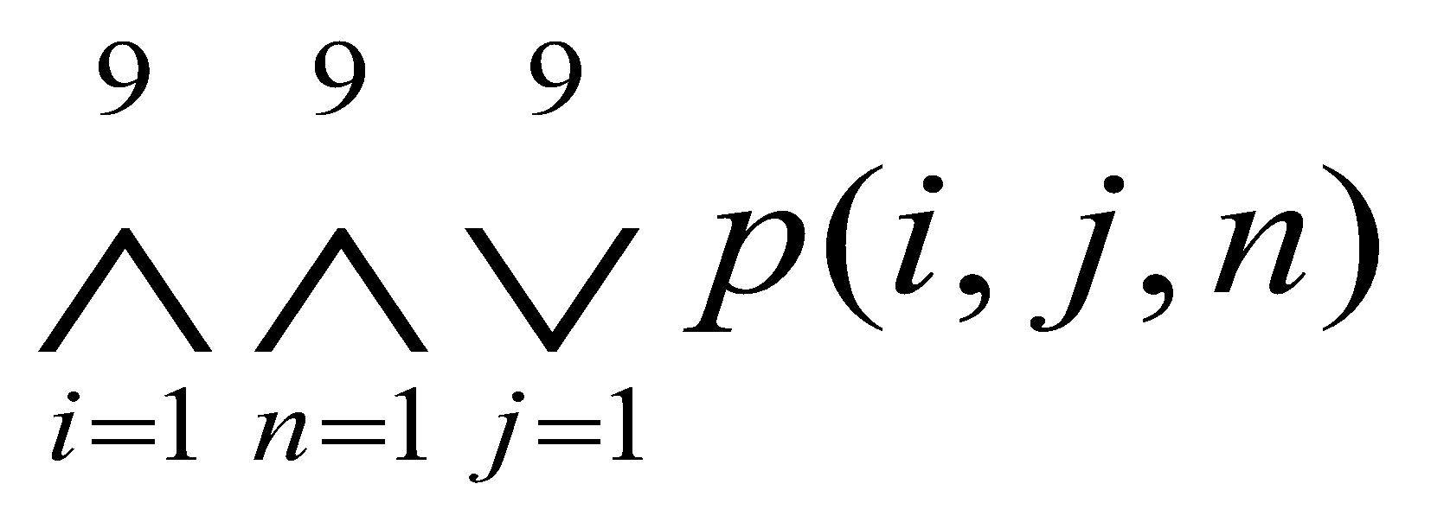
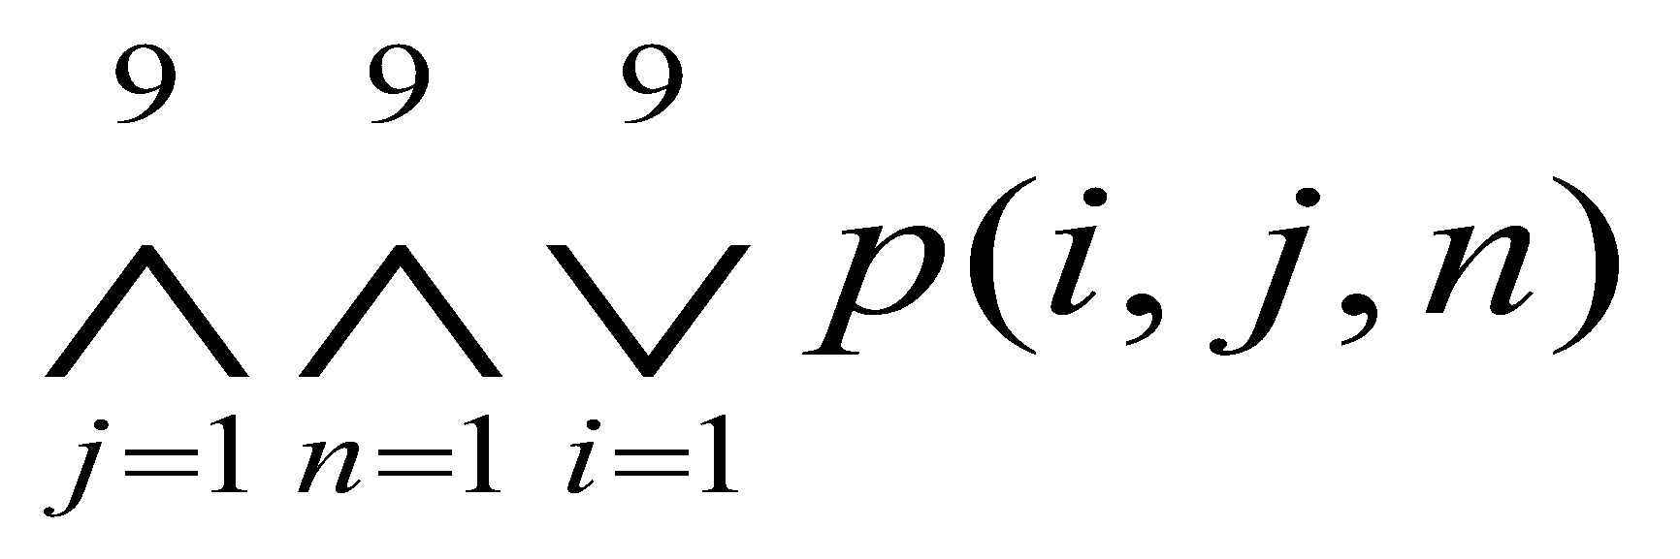
Lecture1: Solving Sudoku puzzle
For each cell with a given value, assert p(i, j, n) when the cell in row i and column j has the given value n.
Assert every row contains every number
Assert every column contains every number

Slide 35
Lecture1: Application of Satisfiability # Solving Sudoku Puzzle
[p(1,1,1) ∨ p(1,2,1) ∨ …… ∨ p(1,9,1)] ∧ [p(1,1,2) ∨ p(1,2,2) ∨ …… ∨ p(1,9,2)] ∧ …… ∧[p(1,1,9) ∨ p(1,2,9) ∨ …… ∨ p(1,9,9)] ∧ [p(2,1,1) ∨ p(2,2,1) ∨ …… ∨ p(2,9,1)]…..

Slide 36
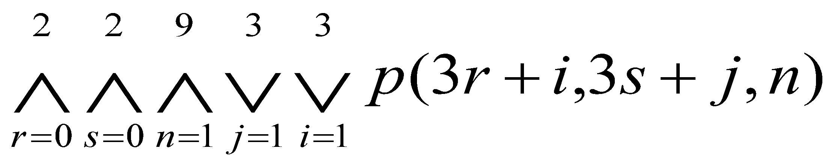
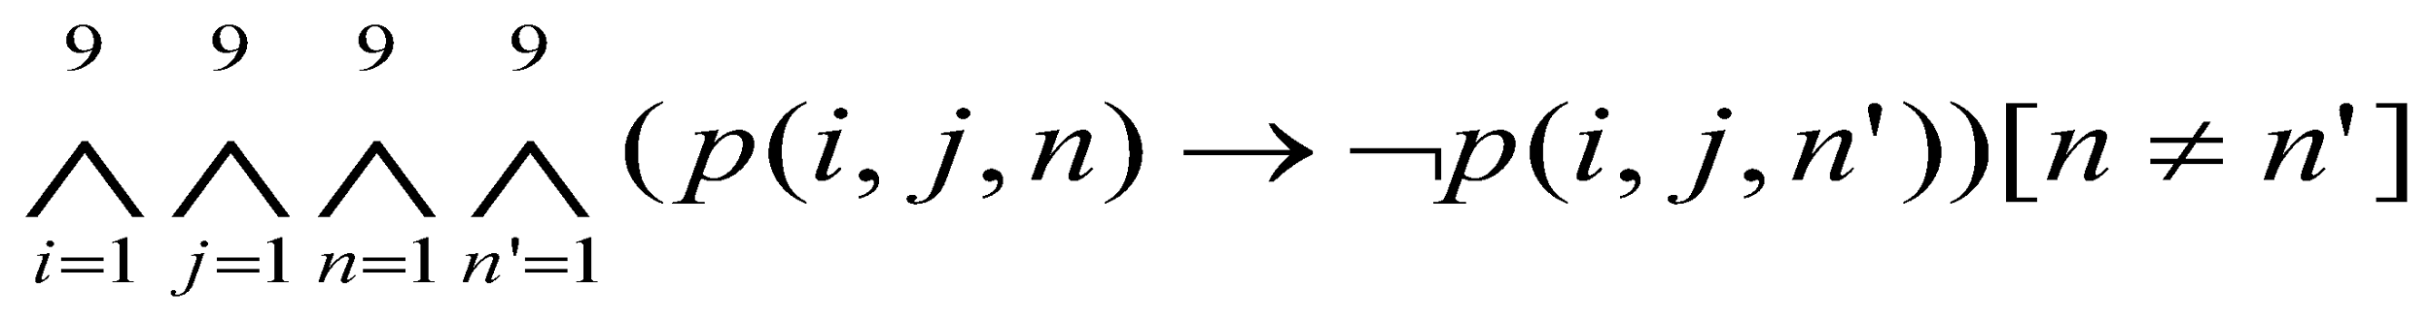
Lecture1: Solving Sudoku puzzle
Assert each of the 9 3x3 blocks contains every number.
No cell contains more than one number

Slide 37
Exercise
Write down the clauses for 3 x 3 Sudoku puzzle.
Implement 2-SAT Algorithm

Slide 38
Prolog
https://www.swi-prolog.org/

